Slide 1
TELECOM CHURN ANALYSIS
SNEHA OWANDKAR

Slide 2
INTRODUCTION
Churn Prediction is one of the most popular Big Data use cases in business. It consists of detecting customers who are likely to cancel a subscription to a service.
Churn is a problem for telecom companies because it is more expensive to acquire a new customer than to keep Wireless your existing one from leaving.
Wireless companies today measure voluntary churn by a monthly figure, such as 1.9% or2.1%

Slide 3
Business Understanding
Profound Question:
For this project, I have obtained a longstanding telecom customer dataset of a telecom (mobile) company which aims to predict competition is to build a model, learned using historical data, that will determine churners in the telecom company.
Objective:
The classification goal is to derive rules and predict whether a customer will churn or not by using KNN and variable churn algorithms and compare both the model accuracies.
Accomplishments:
By using this model, we can increase churn prediction efficiency by identifying the main variables which result in churning, and have a more relational estimate about which customers are potential churners that we should contact first.

Slide 4

CROSS-INDUSTRY STANDARD PROCESS (CRISP-DM)
Business understanding phase
Data understanding phase
Data preparation phase
Modeling phase
Evaluation phase
Deployment phase

Slide 5
Data Understanding
Dataset Details:
The data is straightforward. Each row represents a subscribing telephone customer. Each column contains customer attributes such as area code, call minutes used during different times of day, charges incurred for services, lifetime account duration, and whether or not the customer. The original dataset contains a total of 3333 rows with 1 dependent variable and 20 independent variables.

Slide 6
Data Understanding
Column Name | Description
Churn(Target variable)-categorical | Did the customer churn or not.(True or False)
State | Categorical, for the 50 states & the District Columbia
Account length | Integer-valued, how long account has been active
Area code | Categorical
International plan | Dichotomous categorical, yes or no
Voicemail plan | Dichotomous categorical, yes or no
Total international minutes | Continues, minutes customers used service to make international call
Total international calls | Integer valued
Total international charges | Continuous, perhaps based on foregoing two variables

Slide 7
Column Name | Description
Number of voice mail messages | Integer valued
Total day minutes | Continues, minutes customers used service during the day
Total day calls | Integer valued
Total day charge | Continuous, based on foregoing two variables
Total evening minutes | Continuous minutes customer used service during the evening
Total evening calls | Integer valued
Total evening charges | Continuous, perhaps based on foregoing two variables
Total night minutes | Continuous minutes customer used service during the night
Total night calls | Integer valued
Total night charge | Continuous, perhaps based on foregoing two variables
Number of cell to customer service | Integer valued

Slide 8
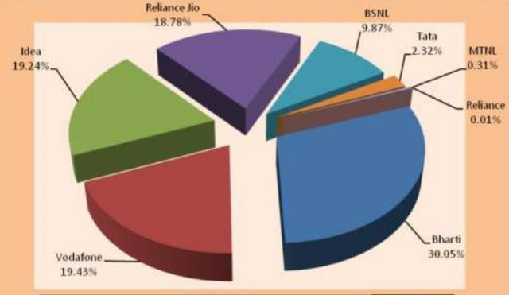
Indian telecom market
The total telecom base grew by 0.34 percent to reach 90.005 crore.
Mobile/wireless subscriber base increased to 87 crore at the end of May 2013, registering a monthly growth of 0.37 percent

Slide 9
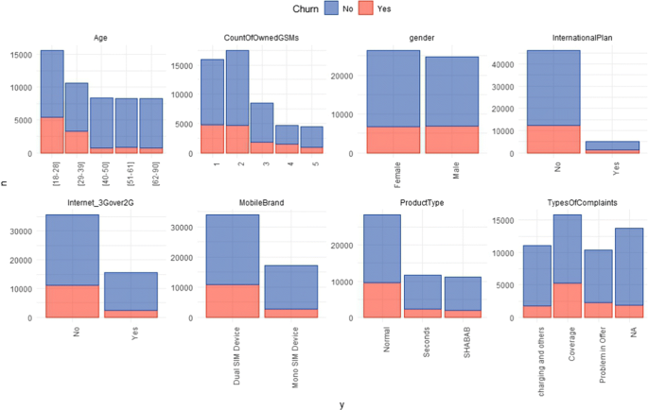
Customer churn prediction in telecom

Slide 10
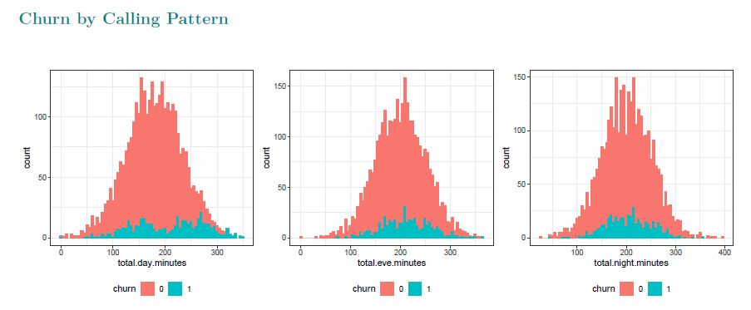
Churn by calling pattern

Slide 11
How to reduce customer churn
Lean into your best customers.
Be proactive with communication.
Define a roadmap for your new customer.
Offer incentives.
Ask for feedback often.
Analyze churn when it happens.
Stay competitive.

Slide 12


Slide 13
Findings and suggestions
Try to offer the better service for the churn customers, see how much this impact before and later. Some may use your service better move them to your active customers.
Take the feedback and suggestions with in period of time and improve it, strive for better communication.
When you are taking the any change in plans of your business just predict the positive and negative share of that plan. If it is negative prepare the solution before so you can handy easily.

